Slide 1
E-business Tech
Lecture 4

Slide 2
Online presence
While offering top-quality goods and services backed by a team of devoted specialists provides a great foundation for a successful business, you still need to build an online presence to truly get noticed.

Slide 3
Provide a great user experience.
Ensure it’s easy for people to find your contact details if they need to get in touch.
Create an appealing design with a stylish color scheme, readable fonts and engaging visuals.
Make sure all the forms and buttons on your site work as intended.
Structure your site so everything is straightforward and logically links all your categories, subcategories and pages.

Slide 4
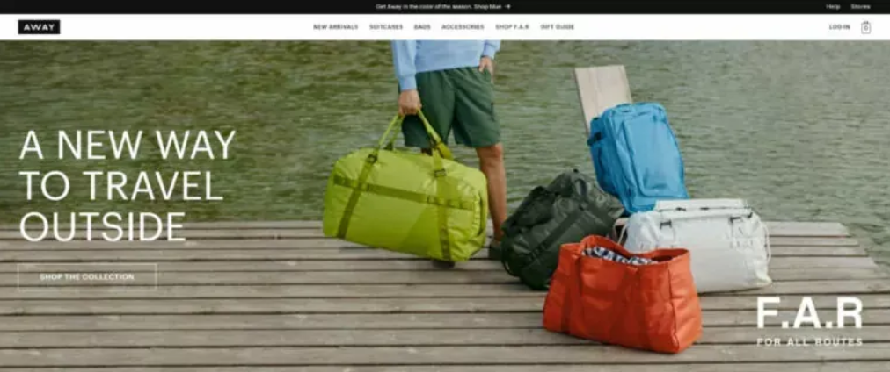
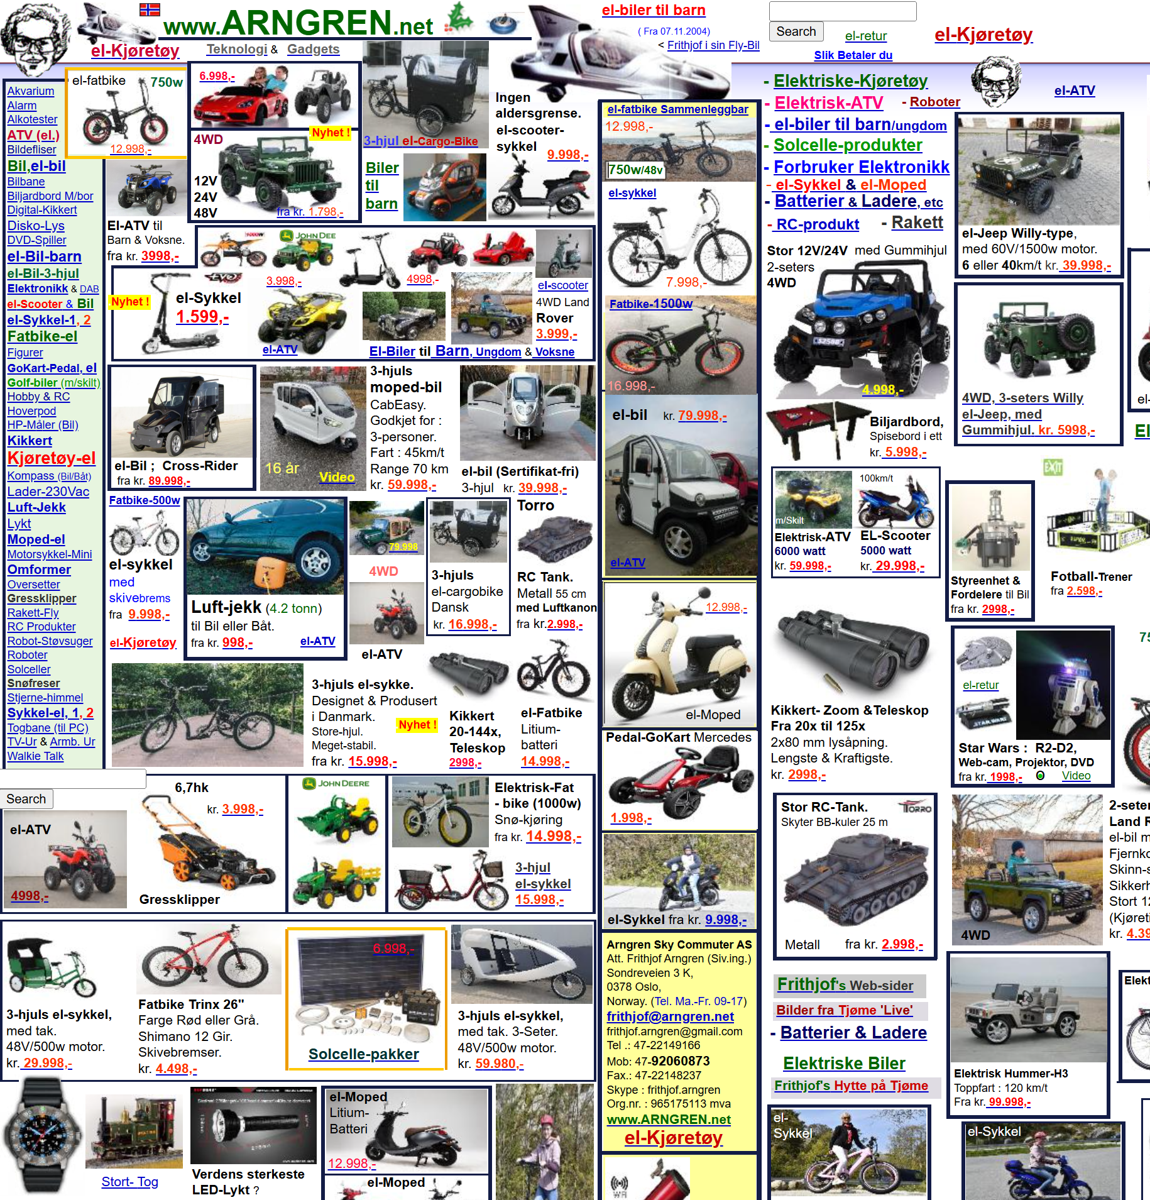

Slide 5
Think mobile-first.
it is important to deliver information about your products and services in an optimized mobile format. Without this, your pages load slowly on smartphones and tablets, and will be difficult to view, alienating mobile users.

Slide 6
Make your website 100 percent secure.
If your website enables shoppers to pay online and requires them to provide personal data, you need to build trust with e-commerce customers by collaborating with a reputable security service and using reliable encryption algorithms to protect sensitive data.

Slide 7
Take advantage of social media and influencers.
The platforms you choose depend on the specifics of your business. Certain brands are unlikely to find an audience on Instagram or YouTube. If you are unsure where you fit in, begin your social media marketing on LinkedIn, Facebook and X (formerly Twitter). This trio is suitable for almost any company.
Post daily short messages, take polls, organize contests and ask your followers questions. The main thing is that your brand’s name regularly pops up in the newsfeed of your target audience.
You can approach influencers you like yourself or work with a third-party agency that will match you up with them.

Slide 8
Use email to reach prospects.
In comparison with social media, email newsletters may seem somewhat obsolete, but it is still an effective channel of communication.
To build a quality email list, categorize your subscribers by repeat customers, recent subscribers and former customers you lost touch with. Customize your messages to each group, selecting words that resonate with each to drive active buyer behavior. Pay attention to the timing and frequency of your emails to avoid being too intrusive and to make sure your prospects see and read your messages.

Slide 9
Start creating and distributing content.
You can use your small business blog to provide information about the high-quality products or services your brand offers, highlight their benefits, answer commonly asked questions, foresee challenges customers may face and provide simple solutions.
Remember to blog frequently — a few times a week should be enough. Vary the content to keep it interesting to readers. For example, how-to guides, product use tips and case studies all get great engagement.

Slide 10
Participate in online forums and communities.
First, it’s another place to list your business. Make sure you maintain the consistency with your business name, address and phone number on these sites as you did with your Google Business Profile and other directory listings.
Second, it’s a great place to show off your expertise and build your professional reputation. Find forums, discussion boards or social media groups where your target audience congregates. Answer questions and be generous with your advice without being too overly promotional.

Slide 11
Have a live chatbot
New AI-powered chatbots can answer detailed questions about your products and services at any time of the day and night. If you connect your chatbot to your e-commerce or CRM platform, your client may be able to log in and ask for details on outstanding orders and get answers to their other questions.
Chatbots are great for improving customer service and they can also turn initial conversations into sales and actionable leads.

Slide 12
Launch paid advertising campaigns.
One way to get to the top of search engines and in the news feeds of Facebook, Instagram and LinkedIn users is with paid advertising.
Depending on the platform, you can bid on keywords searchers use; audience demographics like age and location as well as behavioral and buying habits. You can create campaigns seen by the types of people and businesses you specify.
In most cases, you are only charged when someone clicks on your advertisement. Industry statistics suggest the average cost per click is $4.66. Google and Facebook have the highest returns on investment with Google topping out at 200 percent.

Slide 13
Produce engaging video content.
The average American spends about 48 minutes per day on YouTube, according to Statista. They’ll also watch more videos on their Facebook, LinkedIn, Instagram and X newsfeeds. The ability of video to capture and keep attention is clear.
The types of videos you might consider creating to engage customers includes:
Customer testimonials: Build trust and credibility among viewers by showing real customers talking about their positive experience with your company.
Behind-the-scenes footage: People are curious to know what goes on in the factories and offices of the businesses they buy from.
Before/after videos: If you’re in a visually driven industry like fitness, beauty or home improvement, show the positive impact of your products and services by highlighting how they transform customers’ lives.
How-to guides: How-to guides are great ways of showing customers how to get the most out of your products and services. You could also offer “expert level” videos to show off some of the lesser known use cases. How-to guides position your company as helpful and customer-centered.

Slide 14
Optimize your site for search engines.
A well-planned and executed search engine optimization (SEO) strategy can help you with this. Key tactics you can use include:
Posting high-quality content that Google recognizes as authoritative
Using relevant keywords in your content, titles and meta descriptions
Making sure your website is mobile-responsive
Optimizing your website’s loading speed so visitors don’t have to wait
Getting authoritative sites to link back to your website

Slide 15
How Search Engines Work
SEO: the process of optimizing contents to be discovered by search engine organic results.
Imagine the internet as a vast library, filled with countless books on every conceivable topic. How would you find a specific book without knowing its exact location? A search engine acts like a librarian, helping you navigate this digital library.

Slide 16
Why SEO
Unlike paying for ads, its free
Organic results are consistent once you rank high.
You have opportunity to reach massive audiences.

Slide 17
Crawling
Web Crawlers (Spiders): These are automated programs that explore the internet, following links (seeds) from one webpage to another.
Indexing: As they crawl, they gather information about each webpage, including its content, keywords, and links.
This information is stored in a massive database called an index.

Slide 18
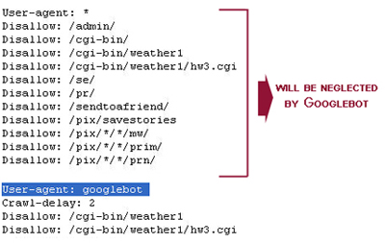
Crawling
All commercial search engine crawlers begin crawling a website by downloading its robots.txt file, which contains rules about what pages search engines should or should not crawl on the website. The robots.txt file may also contain information about sitemaps; this contains lists of URLs that the site wants a search engine crawler to crawl.
During the crawl, Google renders the page and runs any JavaScript it finds using a recent version of Chrome, similar to how your browser renders pages you visit. Rendering is important because websites often rely on JavaScript to bring content to the page, and without rendering Google might not see that content.
Search engine crawlers use a number of algorithms and rules to determine how frequently a page should be re-crawled and how many pages on a site should be indexed. For example, a page that changes on a regular basis may be crawled more frequently than one that is rarely modified.

Slide 19
Indexing
After a page is crawled, Google tries to understand what the page is about. This stage is called indexing and it includes processing and analyzing the textual content and key content tags and attributes, such as <title> elements.
During the indexing process, Google determines if a page is a duplicate of another page on the internet or canonical. The canonical is the page that may be shown in search results. To select the canonical, group together (also known as clustering) the pages that was found on the internet that have similar content, and then select the one that's most representative of the group.
The other pages in the group are alternate versions that may be served in different contexts, like if the user is searching from a mobile device or they're looking for a very specific page from that cluster.

Slide 20
Google search algorithms
Google's algorithms are complex mechanisms used to retrieve information from its search index and present the information to a given query. Algorithms sift through billions of pieces of content in Google's index, looking for phrases and keywords that match the query.
Google keeps the details of its search ranking algorithm private but uses hundreds of specific criteria to rank content, including backlinks, page speed and content quality. The search company also regularly updates its algorithm to improve the quality of search results and stay ahead of spammers on the platform.

Slide 21
How search engines display results
Meaning of your query (Intent)
recognizing and correcting spelling mistakes, synonym system that allows to find relevant documents even if they don’t contain the exact words you used. For example, you might have searched for “change laptop brightness” but the manufacturer has written “adjust laptop brightness.” Our systems understand the words and intent are related and so connect you with the right content.
context
Keywords, language, localization, current events
Relevance of content
The most basic signal that information is relevant is when content contains the same keywords as your search query.
Quality of content
determine which content demonstrates expertise, authoritativeness, and trustworthiness.
Usability
When all other signals are relatively equal, content that people will find more accessible may perform better. For example, mobile-friendly content that loads quickly.

Slide 22
Keyword search
Keywords are words typed by users to find what they look for.
Engines rank sites based on keywords audience search for
Keyword research
The process of finding keywords people search for in engines

Slide 23
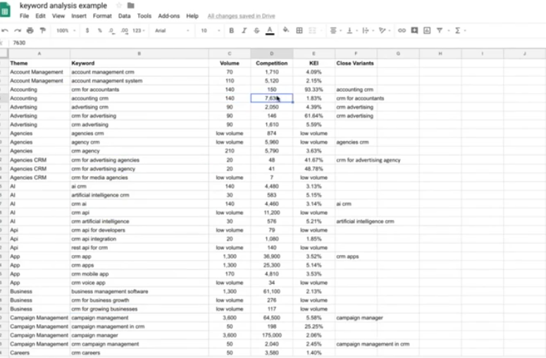
Keyword research
Check for demand (volume)
Use keyword explorer
Check potential for the topic
To rank high using this word
SERP Checker shows you how much organic search traffic the top results get from all the keywords they rank for. Once you know which pages on the SERPs get the most traffic, you can analyze them in Site Explorer to replicate their success.
Assess the potential word for business
Assign rates
See if you can match searcher intent
Rank you keyword

Slide 24
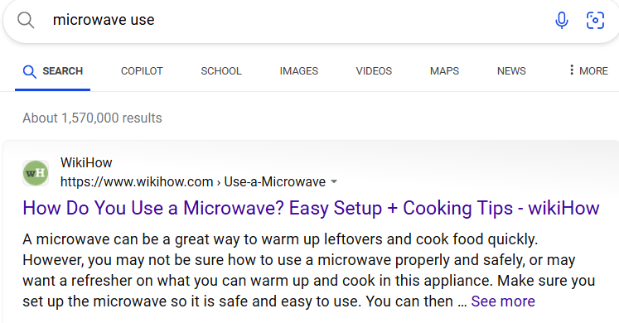
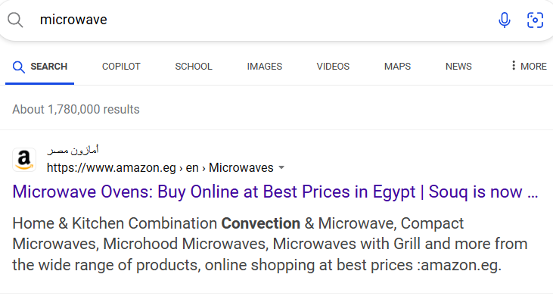
Search intent
Must match intent to show the search engine that you achieve goal.
Search for the word and analyze results.

Slide 25
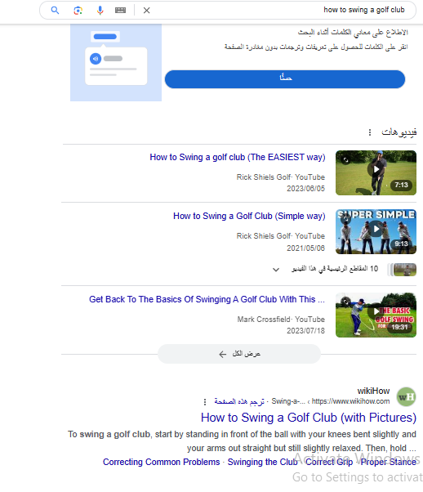
3c of search intent
Content type
Posts
Videos
Content format
How to
Step by step tutorial
Lists
Content angle
Benefit why click (basic)

Slide 26
Generating keywords
Several tools help marketers identify the most important keywords, including these six:
Clearscope
Google Ads Keyword Planner
Google Trends
Keyword Tool
Semrush
SpyFu
Choose keywords that
Match intent
Have search volume
Business related

Slide 27
Generating keywords
Analyze Competition and Search Volume
Use tools like Ahrefs or Google Keyword Planner to check the search volume and competition for your new long-tail keywords. You’ll often find that these long-tail keyword modifiers have lower competition compared to the broad keyword “laptop,” making them easier to rank for.
Integrate Modifiers into Your Content
Now that you’ve selected your keyword modifiers, it’s time to integrate them into your content. This includes:
Page Titles: Use the modified keyword in your page title, e.g., “Best Laptops for Students in 2024.”
Meta Descriptions: Craft a meta description that includes the modifier, making it clear and enticing, e.g., “Discover the top laptops for students with long battery life and affordable prices.”
Headings and Subheadings: Use the modified keywords in your H1, H2, and H3 tags to reinforce the topic throughout your content.
Body Text: Naturally include the keyword modifiers in your content, ensuring it flows well and provides value to the reader.

Slide 28
Technical on page SEO
Include target keyword in your title when it makes sense.
Use a short and descriptive URL
Meta descriptions
Add internal links
Optimize images
Optimize readability

Slide 29
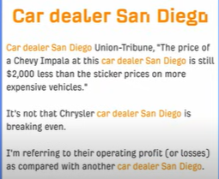
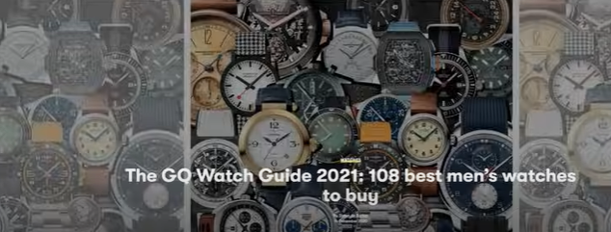
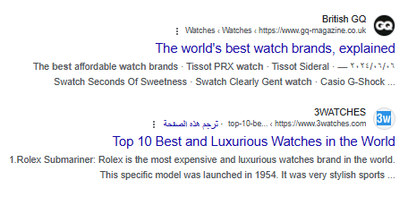
On page SEO
Ranking high by matching search intent using html tags like titles and meta descriptions.
Its not about
Stuffing exact keywords
Using keywords a specific
Number

Slide 30
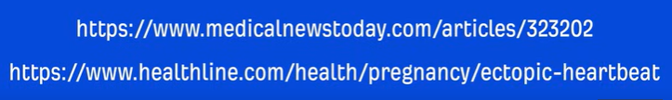
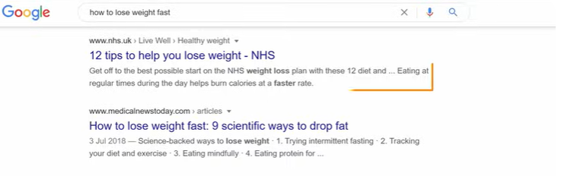
Technical on page SEO
Include keywords in title when it makes sense
Use descriptive URLS (help people understand what is it about before visiting page)
Meta descriptions that summarize page (not a ranking signal but can affect traffic) (title 60 character, meta description 155 character)

Slide 31
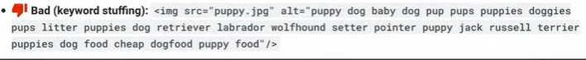
Technical on page SEO
Internal links on the same site
Help search engines
Optimize your images
Name appropriately (files give clues about contents)
Use descriptive ALT text
Compress (page load time is a factor)

Slide 32
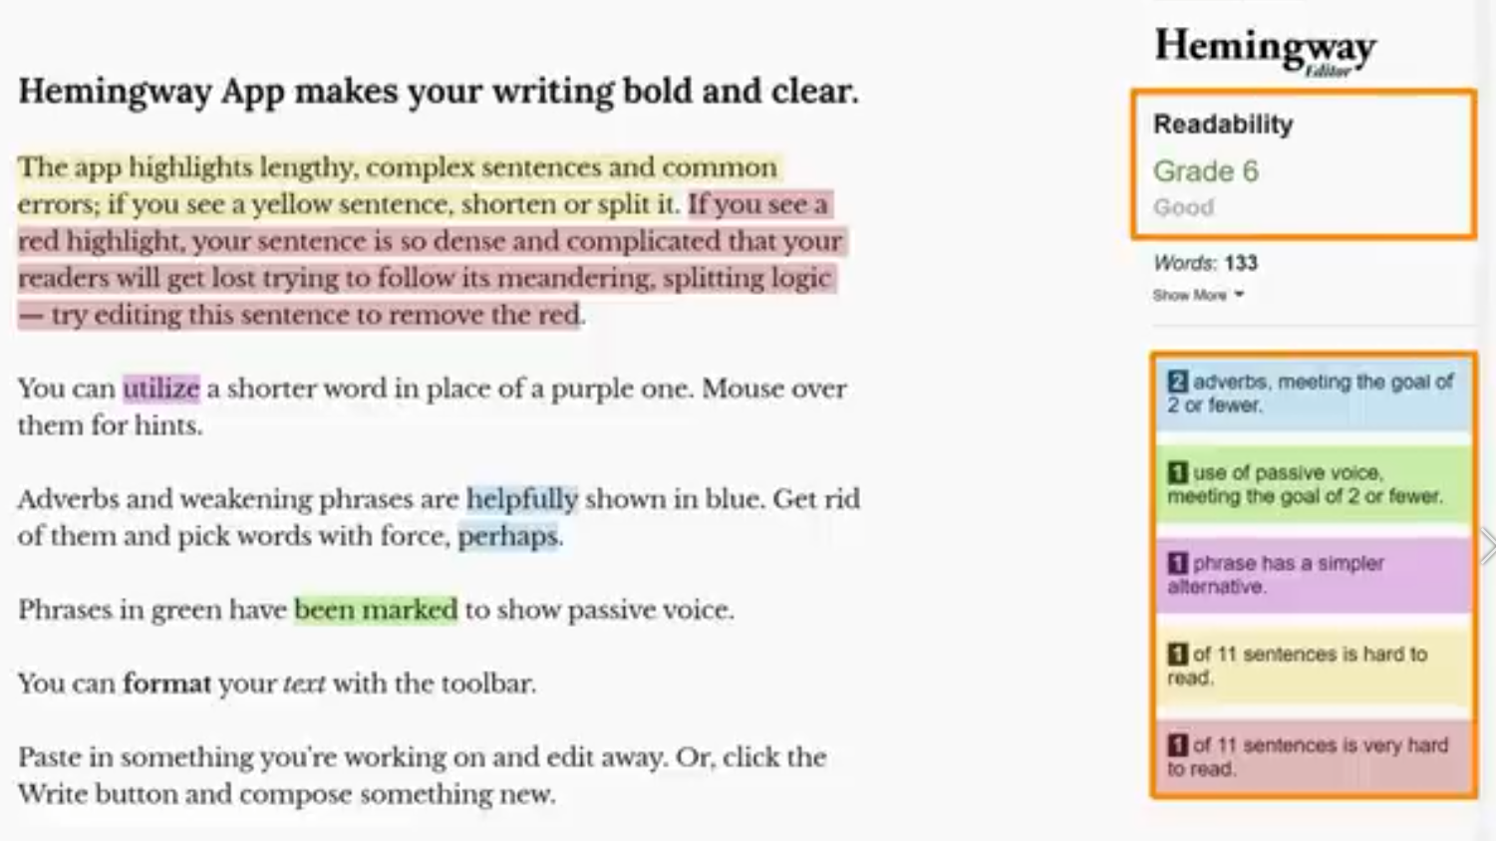
Optimize readability
Write short sentence and paragraphs
Use descriptive subheading
Use large fonts readable on desktop and mobile
Write as you speak

Slide 33
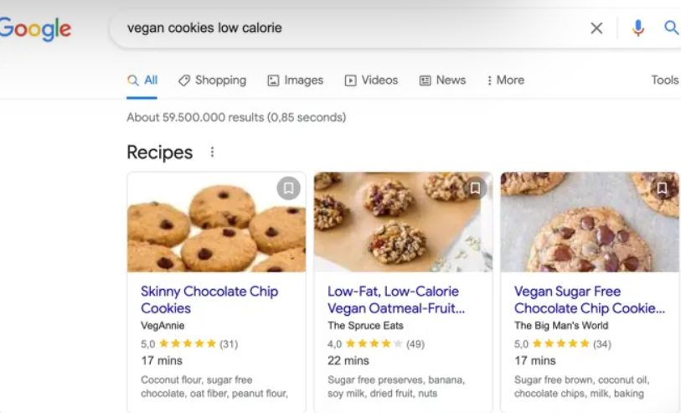
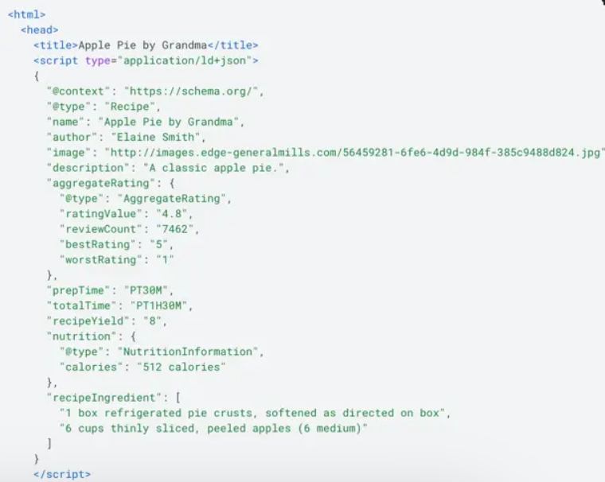
Use schema markup
you need to make sure search engines recognize your content for what it is. You need to speak the language they use to look through your content (both textual and visual).
And to speak it, you can add schema markup to your website - structured data in the form of code that can guide search engines in understanding your pages and content elements.
How to Add Structured Data in Joomla (tassos.gr)

Slide 34
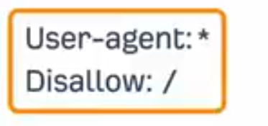
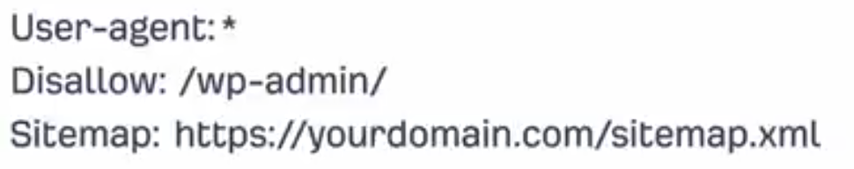
Technical SEO notes
donot block search engines
Robots.txt
Check also for not blocking
Sitemaps
XML files listing important pages
Joomla sitemaps

Slide 35
Site
Ensure pages donot load slow
Cache your site contents
Compress your images
Avoid factors affecting rankings
Broken links
Orphan pages (no internal links)
Duplicate contents

Slide 36
Off site SEO Link building
The process of getting other websites to link to your website (backlinks) because it enhances their sites.
The process is more relational and can take more time than you might like
Search engines rank pages by looking at the quantity and quality of other pages that link to it.

Slide 37
How to get backlinks
Create
Manually add links on a domain back to yours
Add it in a blog comment or social media
Easy to do but less effective
Buy
Pay websites a fee for a backlink
Average cost of buying a link around 350$
Easy to do and highly effective unless you get caught
Earn
Use e-mail outreach
Becoming a source for a media outlet

Slide 38
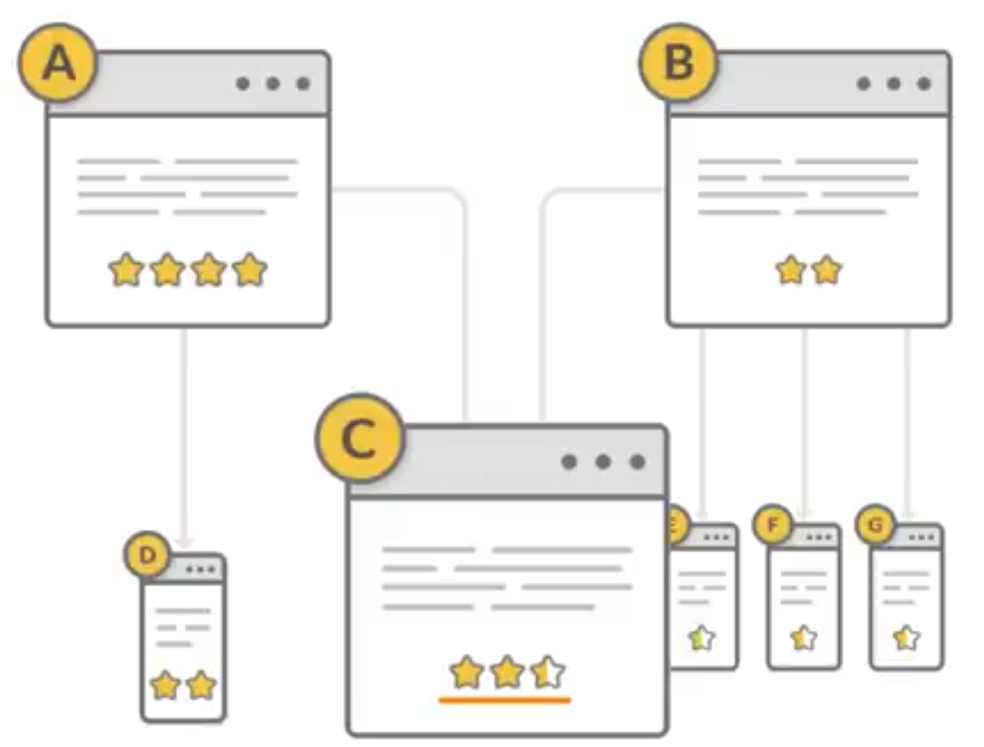
What makes backlink high quality
Relevance (topic relevant)
Authority (link power)
Link placement

Slide 39
Link building tactics
Prospecting
Find relevant pages (find as many people that fit criteria)
Vetting
Refine list (select people)
E-mail outreach

Slide 40
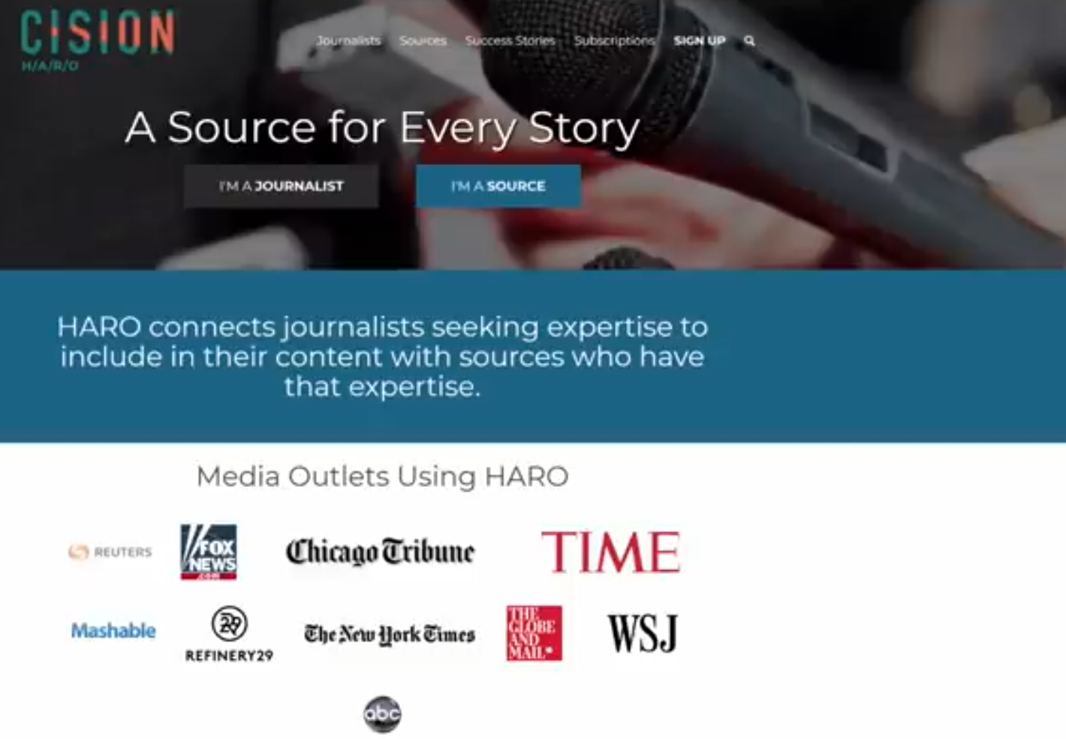
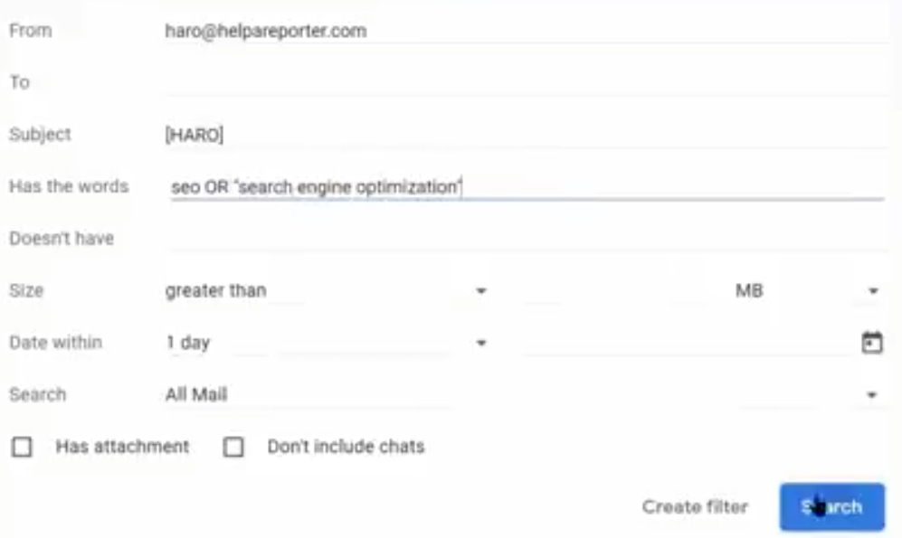
Link building tactics
Get a free reference using HARO
Exchange knowledge for
A mention from site

Slide 41
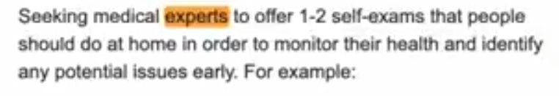
Tips for e-mail writing for HARO
Keep it as short as needed
Go after topics journalists are looking for multiple sources
Respond as quickly as possible
Prioritize questions where you are an expert
Follow all directions in their e-mail

Slide 42
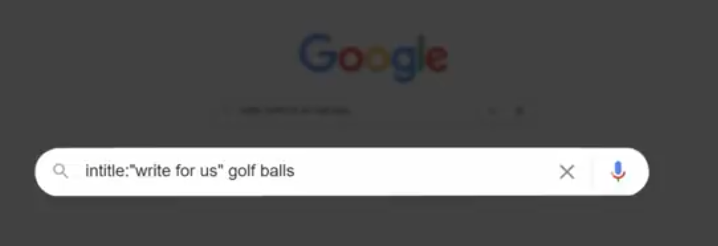
Link building tactics
Guest blogging
Create content for another website
Search for relevant sites using google intitle
Come with a good reason as why to accept your post

Slide 43
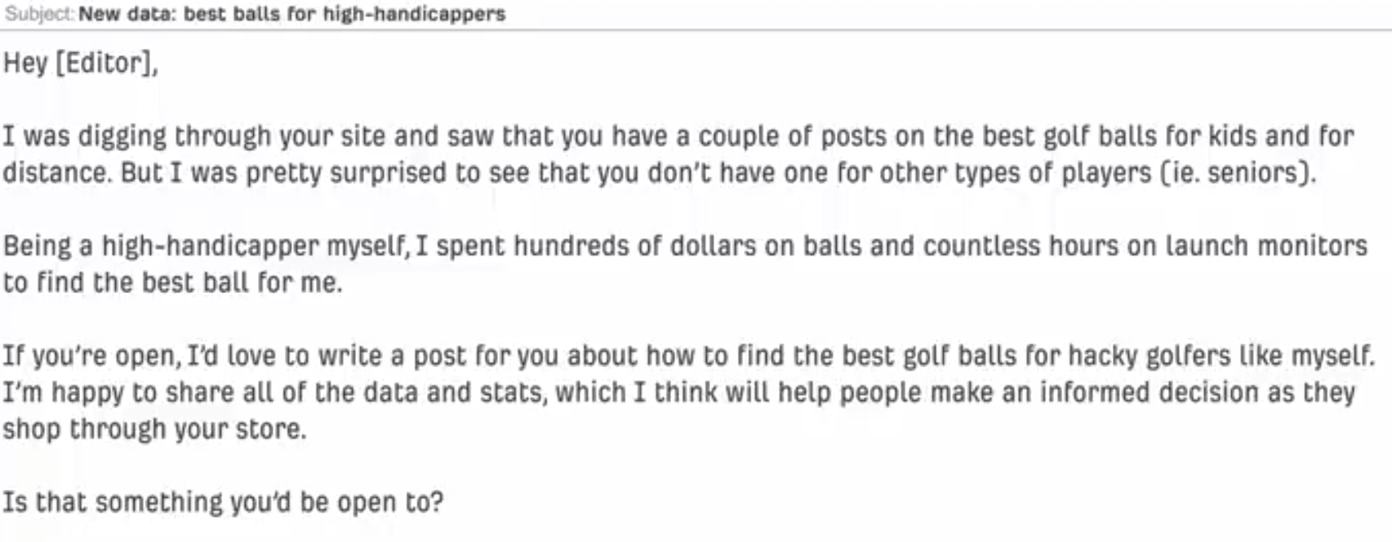
How to write good e-mail
Subject line
Get them to open mail
Describe why e-mail and provoke curiosity
Introduction
Why e-mail them
Qualification
Pitch
Your as and value proposition

Slide 44
Search engine marketing
Search engine marketing (SEM) is a method of promotion and advertising to help companies' content rank higher among search engine traffic. Like search engine optimization (SEO), search engine marketing helps companies improve the way content is ranked by search engines.
It is based on keyword analysis. Marketing departments identify keyword terms that might draw users to a webpage. Like SEO practitioners, search engine marketers use keyword research analysis and tools to identify keyword phrases audiences are searching for. They then buy ad space on the results pages from the search engine provider for the search terms they want to target.

Slide 45
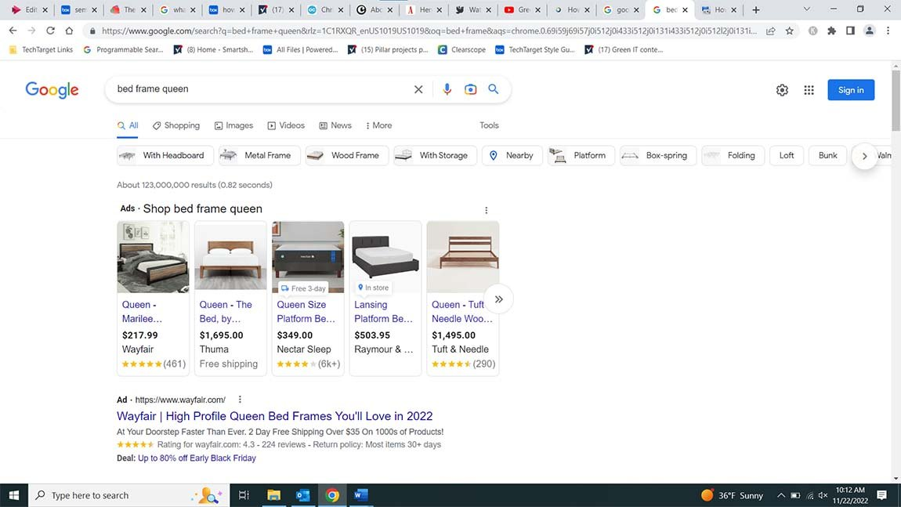
How SEM works
Search engine marketers first identify keywords with large search volumes and then buy ad space on the SERPs for those keywords. These campaigns pay per click (PPC), which means the marketer pays the search engine provider every time a user clicks its ad.
SEM ads are placed at the top of a SERP, above the organic results generated by SEO.

Slide 46
How ad auctions work
For Google, Bing and Yahoo, all ads must go through an auction process that takes place every time a user makes a search
The SEM campaign with the biggest budget does not always get the top spot. Competitors with a lower bid can win ad space over organizations with higher bids if their content is more relevant. Also, some of the factors that determine organic search engine ranking also come into play in the Google auction, such as trust signals and web traffic.

Slide 47
How ad auctions work
Bidding. The SEM campaign enters the maximum amount it is willing to pay for a keyword.
Quality score. Platforms like Google Ads grade the ad and the website hosting it based on the keywords used, the UX of the website, how useful the content on the ad's landing page is and ad assets, such as phone numbers and links that might be useful to visitors.
Context considerations. Because auctions happen every time a user makes a search, search engines like Google and Bing also consider contextual information in determining an ad's ranking. These include the searcher's physical location, search history, the time of the search, the device used to make the search, and other ads and organic search results on the page.
Ad rank determined. An ad rank is awarded to the bidder. Because of all the metrics Google considers in addition to the price of the bid, the highest ad rank is not guaranteed to go to the highest bidder.

